Slide 1

LET’S TALK ABOUT GAMBLING

Slide 2

WHAT IS GAMBLING?
Gambling happens when you play any game of chance or skill, in which you stake something valuable that has potential for a prize win.

Slide 3


WHAT DOES GAMBLING LOOK LIKE?
Many people think of gambling as the money-based games you play in casinos, racinos, and lotteries.
Notes:
Speaker notes:
Examples:
Casinos and Racinos — blackjack, poker, craps, slot machines, etc.
Lottery — jackpots like Powerball, daily draws like Pick 3, and specialty games like Scratch-Offs and Keno, and more.

Slide 4

WHAT DOES GAMBLING LOOK LIKE?
More recently, gambling happens online through sports betting apps, prediction market platforms, and even video games
Notes:
Speaker notes:
Examples:
Sports betting — parleys, over/unders, futures, prop bets, point spreads, etc.
Prediction markets — on platforms like Kalshi and Polymarket.
Video games — loot boxes, skin buying and trading, gacha systems, and more.

Slide 5
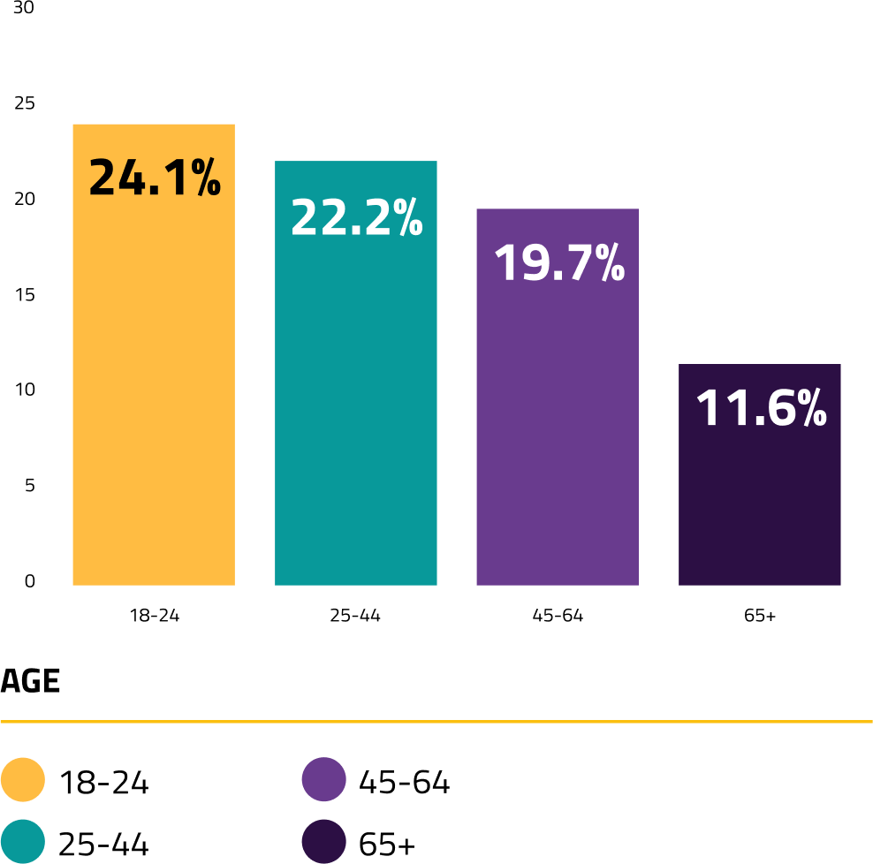
HOW POPULAR IS GAMBLING?
In 2022, only 17.2% of Ohio adults said they don’t gamble.
This graph highlights the prevalence of at-risk/disordered gambling by different ages.
Source: 2022 Ohio Gambling Survey
Notes:
Speaker notes:
Gambling disorders affect all ages differently. Knowing how your age group is impacted can help you prevent gambling-related harms.
[if speaking to college students] For example, college students make up a large population for at-risk gambling nationwide.
6% of college students experience gambling disorders — more than double the general population.
3 out of 4 college students have reported engaging in some form of betting.
For more age and population-specific statistics, refer to the 2022 Ohio Gambling Survey.

Slide 6

WHAT IS A GAMBLING DISORDER?

Slide 7

WHAT IS A
GAMBLING DISORDER?
A gambling disorder is a pattern of gambling behaviors that occurs when a person’s gambling goes beyond entertainment to become a preoccupation and disrupt their personal, family, or work life.
Notes:
Speaker notes:
Callout that it is a diagnosable and treatable condition, like other addictions.
People may also hear it referred to as “problem gambling” or “gambling addiction”.

Slide 8






THE WARNING SIGNS
Disordered gambling can show up through:
Borrowing money
Feeling restless or irritable
Withdrawing from relationships or hobbies
Chasing losses
Hiding how much time or money is spent
Exaggerating wins and minimizing losses
Notes:
Speaker notes:
Callout that if you or someone you know is demonstrating multiple warning signs, utilize the resources at the end of this presentation for help and support.
Note, these are just some of the warning signs. Find more information on the website.

Slide 9



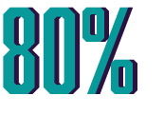
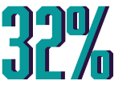
THE CONSEQUENCES OF A GAMBLING DISORDER
People experiencing a gambling disorder are twice as likely to experience mood disorders like depression.
People experiencing a gambling disorder are three times as likely to experience alcohol or drug dependency.
Researchers estimate that more than 80% of people experiencing a gambling disorder never seek treatment.
About 32% of people experiencing a gambling disorder consider dying by suicide.

Slide 10

THE RISKS OF BETTING

Slide 11






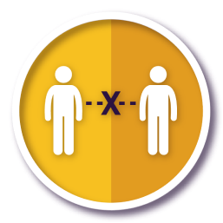
POPULATIONS THAT EXPERIENCE A HIGHER RISK
Men ages 18-44
Women ages 50+
Children and teenagers
Minority Communities
People who experience addiction or depression
Family members of individuals experiencing a gambling disorder
People separated from spouses or widowed
Notes:
Speaker notes:
It’s important for people to know if they are at a higher risk for experiencing a gambling disorder. If so, then it is extremely important to follow steps that reduce your risk and help prevent yourself from experiencing other gambling-related harms.
Note, these are just some of the at-risk populations. Find more information on the website.

Slide 12

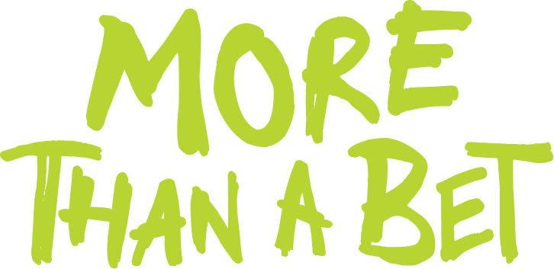



STUDENT ATHLETE BETTING HARRASSMENT PSA
MORE THAN A BET: GAMBLING IMPACTS STUDENT ATHLETES TOO
Since the legalization of sports betting, student athletes have faced alarming amounts of betting-related harassment.
Learn how you can help protect student athletes at MoreThanABet.org.
Notes:
Speaker notes:
If betting causes you to feel the need to harass a student athlete, More Than A Bet can help you find ways to cool down.

Slide 13
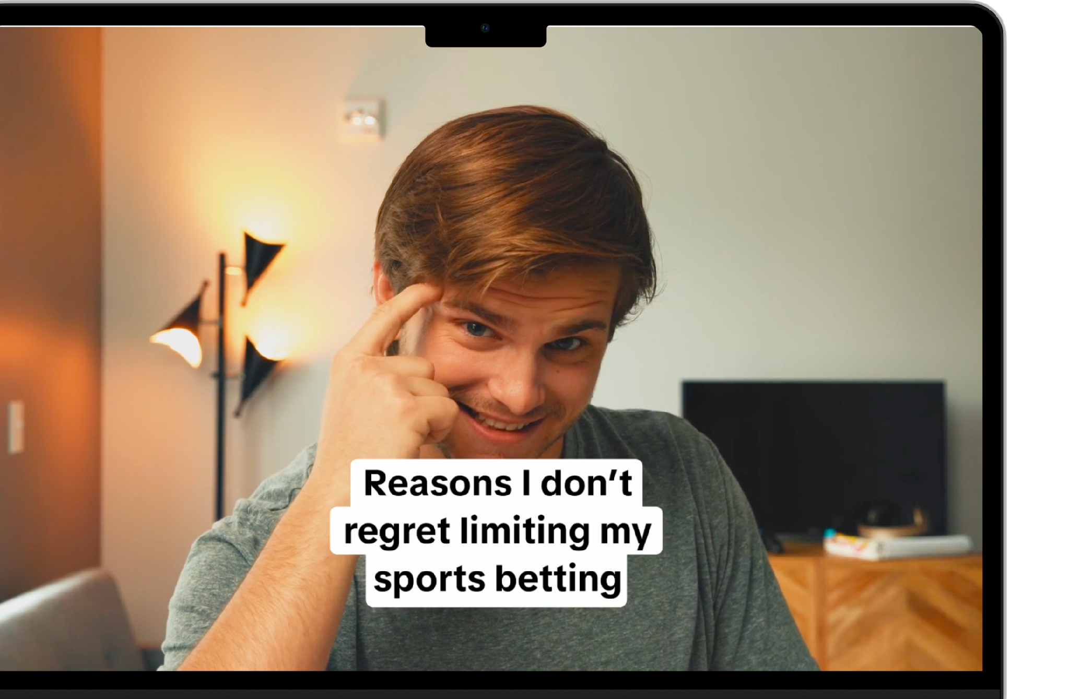
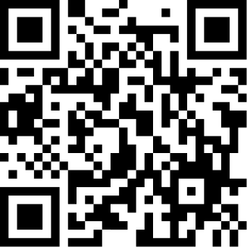

EMERGING ADULTS BETTING PSA
Emerging Adults
PSA video
Notes:
Speaker notes:
This video works great for young adults ages 18-24 to teach what setting limits looks like.
For different audiences, please explore the videos on our community toolkits for messaging that better suits your goals and adjust the presentation accordingly: PauseBeforeYouPlay.org/media-type/video

Slide 14

WHAT ARE THE CONSEQUENCES?
Frequent betting can result in disordered gambling.
A person experiencing a gambling disorder is:
More likely to experience mood disorders or alcohol and drug dependency.
More likely to consider dying by suicide than all other addictive disorders.
Less likely to seek treatment.

Slide 15
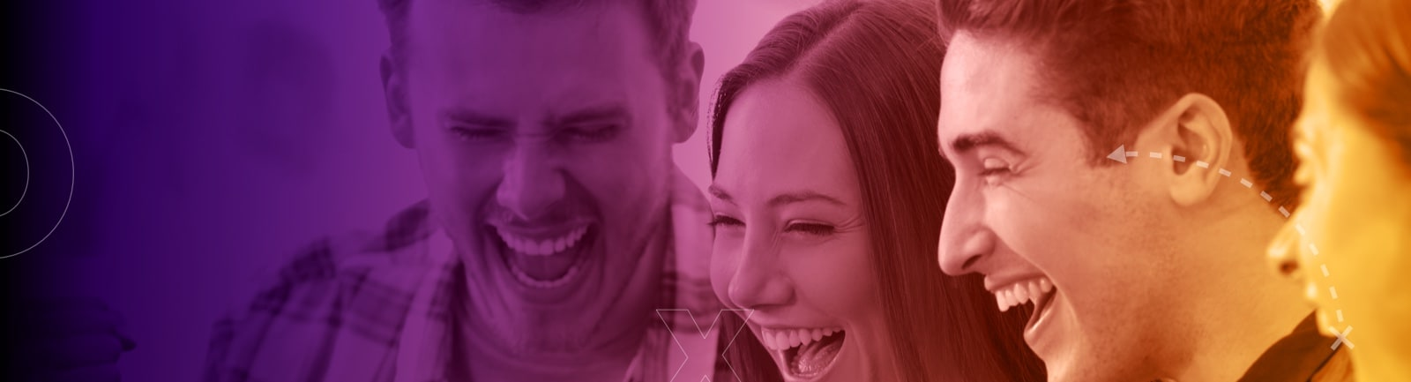
HOW CAN YOU PLAY RESPONSIBLY?

Slide 16
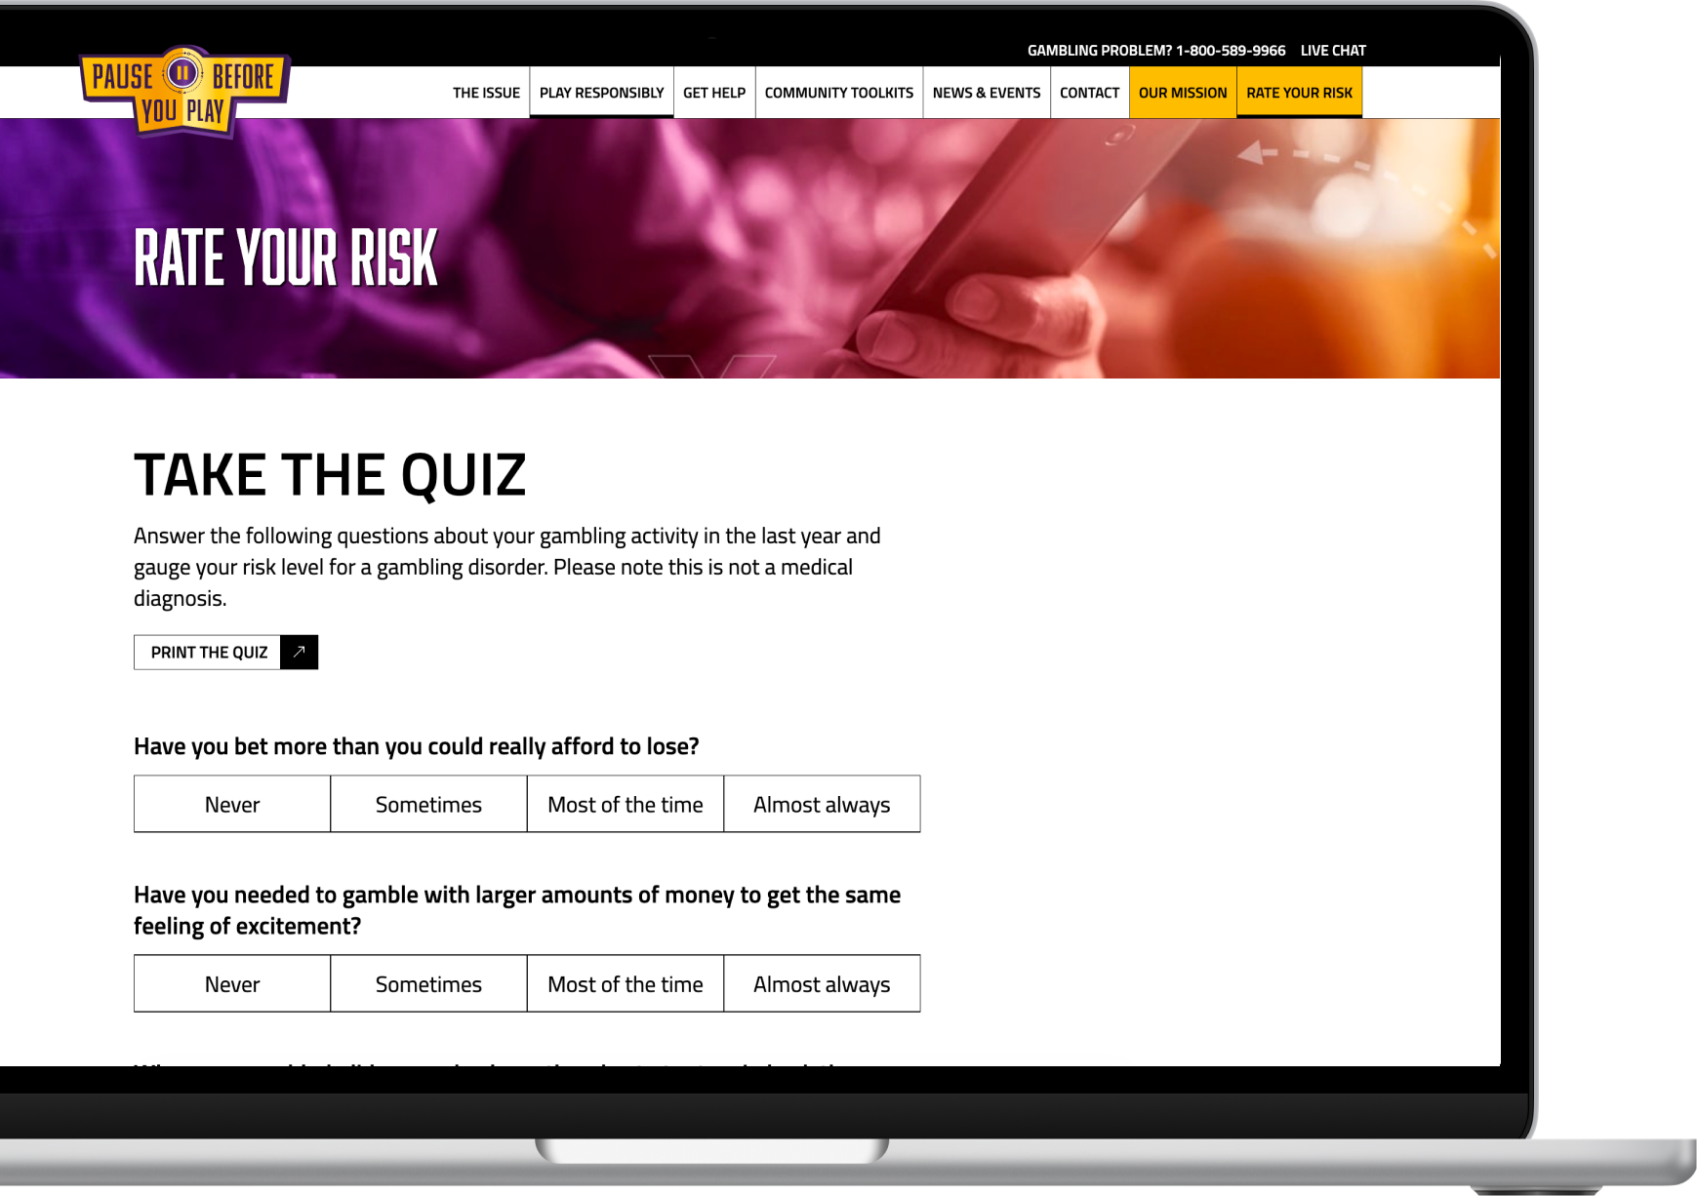
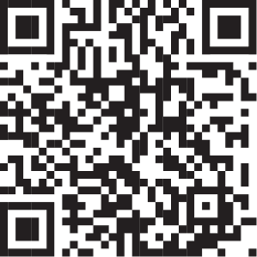
GAUGE YOUR RISK LEVEL
Take the quiz
PauseBeforeYouPlay.org/play-responsibly/rate-your-risk
Notes:
Speaker notes:
This quiz can help you understand the way you engage and learn what you can do to help prevent gambling harms, like disordered gambling.
Please note quiz results are not a medical diagnosis.

Slide 17




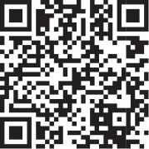
HOW TO LOWER YOUR RISK
HAVE A GAME PLAN
Find more tips at PauseBeforeYouPlay.org/play-responsibly
Notes:
Speaker notes:
This quiz can help you understand the way you engage and learn what you can do to help prevent gambling harms, like disordered gambling.
Please note quiz results are not a medical diagnosis.

Slide 18

SUPPORT IS AVAILABLE
These resources are available to Ohioans at no cost:
Ohio’s Problem Gambling Helpline
  Call 1-800-589-9966
  Text or chat 988
Time Out Ohio
  A voluntary self-ban program with access to useful apps and financial counseling services.
Ohio Gambling Telehealth Network
  A virtual network of specialized counseling providers.
Or, find a support group and other resources on the website.
Notes:
Speaker notes:
Guide audiences to our website to find additional resources and details about each: PauseBeforeYouPlay.org/get-help
Here is a list of additional resources offered by Time Out Ohio:
Gamban — setting mobile restrictions
Gamfin — financial counseling services
RecoverMe — mobile health app

Slide 19

ANY QUESTIONS? LET’S TALK!
PAUSEBEFOREYOUPLAY.ORG

